Slide 1

Smart Agriculture Assistant: AI for Modern Farming
Discover how our AI-powered multilingual farming advisor revolutionises agriculture with real-time insights and voice support, empowering farmers for a more productive future.

Slide 2






Key Features of the Assistant
Multilingual Support
AI-Powered Agents
Voice Assistant
Assistance available in English, Hindi, and Gujarati for broader accessibility.
Specialised agents for weather, agriculture, PDF analysis, and combined recommendations.
Hands-free interaction with voice input and text-to-speech output in multiple languages.
Document Processing
Weather Integration
Upload PDFs for text extraction, Q&A, and automatic summarisation.
Real-time weather data and location-based, weather-informed crop recommendations.

Slide 3
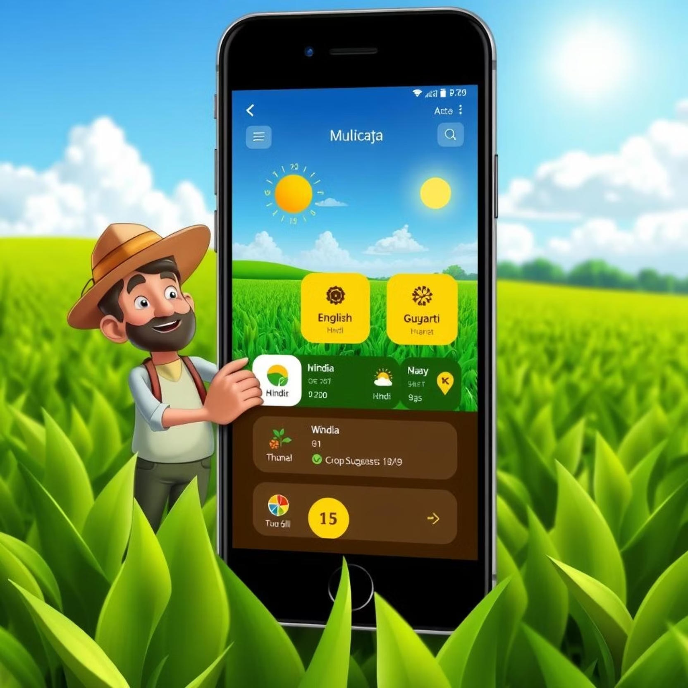
Multilingual Capabilities
Our Smart Agriculture Assistant is designed to break language barriers, providing support in key regional languages to ensure every farmer can access vital information.
English 🇺🇸
Hindi 🇮🇳 (हिंदी)
Gujarati 🇮🇳 (ગુજરાતી)
This feature ensures that farmers can interact with the system in their preferred language, making the technology more accessible and user-friendly.

Slide 4




AI-Powered Agents for Smart Decisions
Weather Agent
Agriculture Agent
Provides real-time weather data and accurate forecasts.
Offers crop recommendations and expert farming advice.
PDF Agent
Combined Agent
Extracts knowledge and analyses agricultural documents.
Delivers integrated weather-based agricultural recommendations.
These specialised AI agents work in synergy to provide comprehensive and context-aware guidance to farmers, optimising their decision-making process.

Slide 5

Seamless Voice Interaction
Our voice assistant enables hands-free interaction, crucial for farmers working in the field. It supports:
Voice input in multiple languages
Text-to-speech output for clear communication
Enabling farmers to receive information and give commands without interrupting their work.

Slide 6

Advanced Document Processing
The assistant can process and extract valuable insights from various agricultural documents.
PDF Upload & Extraction
Seamlessly upload PDF documents for text extraction.
Vector Database Storage
Utilises ChromaDB for efficient storage and retrieval of document data.
Document-Based Q&A
Ask questions directly related to uploaded documents and receive accurate answers.
Automatic Summarisation
Generates concise summaries and key insights from lengthy documents.

